Slide 1
BLOCKCHAIN - BASED
STUDENT CASH SYSTEM
<p> THE STREETS (Patrick Serrano, Hossein Khoshhal, Siva Komaragiri, Nicolle Vigil) </p>

Slide 2
THE PROBLEM
CMU students require fast, low-cost payment options
Traditional payment methods at CMU are bogged down by high fees and slow processing, particularly burdening international students.
There's a pressing need for a payment system that not only improves transaction efficiency but also embodies CMU’s innovative spirit.

Slide 3
THE PROBLEM AT CMU
International Student face:
high fees
Barrier to entry
Pressing Need for:
Transaction efficiency
Embody CMU’s innovative spirit
Students require:
Fast processing
Low-cost payments

Slide 4
THE PROBLEM
CMU students require fast, low-cost payment options
Traditional payment methods at CMU are bogged down by high fees and slow processing
There is a need for Innovation

Slide 5
OBJECTIVE
The aim of our project is to implement a system that:
Gives students back their agency in regards to their student-life related finances
Provides a more accessible and efficient method of tracking, sending, and receiving payments within the school network
Do so in a way that is more secure and accessible to students than traditional payment methods.

Slide 6
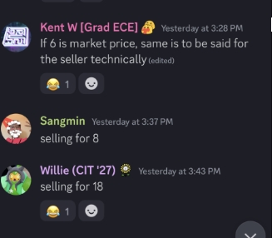
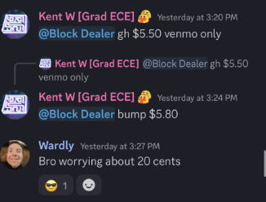
Black Market?

Slide 7
OBJECTIVE
The aim of our project is to implement a system that:
Gives students back their agency in regards to their student-life related finances
Provides a more accessible and efficient method of tracking, sending, and receiving payments within the school network
Do so in a way that is more secure and accessible to students than traditional payment methods.

Slide 8

INTRODUCING ScottPay
<p> A fast, safe, and accessible way to manage payments within the CMU network. </p>

Slide 9
POWERED BY RIPPLE
<p> Inclusive access for ALL students </p>
Vastly easier to enroll into than traditional bank accounts for both domestic and international students, reducing currency exchange dilemmas.
<p> Boosted Security in Schools </p>
Beyond ease of access, ScottPay’s blockchain integrated model becomes much more secure in protecting payments and students.
<p> Unifying the payment process </p>
By making a one-stop shop for all payments needed, students will have complete access to both University and participating third-party services.

Slide 10
SOME FACTS ABOUT
Current Transaction Costs.
10,000 transactions
Daily costs = $3,000.
$0.30 per transaction
MINUTES TO DAYS
for international transactions
for traditional systems.

Slide 11
THE PROBLEM AT CMU
International Student face:
high fees
Barrier to entry
Pressing Need for:
Transaction efficiency
Embody CMU’s innovative spirit
Students require:
Fast processing
Low-cost payments

Slide 12
Potential
Transaction Costs WITH XRP
10,000 transaction
Daily costs
= $2
3-5 SECONDS!
$0.0002 per transaction

Slide 13
THANK YOU!
Email:
hkhoshha@andrew.cmu.edu
pserrano@andrew.cmu.edu
skomarag@andrew.cmu.edu
nvigil@andrew.cmu.edu
Any questions? Reach out!

